Slide 1


Vaibhav Pavtekar
20 Sep 2024

Slide 2

Outline
Executive Summary
Introduction
Methodology
Results
Conclusion
Appendix

Slide 3
Executive Summary
Summary of methodologies
Project data collection
API
Web Scraping
Data Wrangling
Exploratory Analysis
Using SQL
Using Data Visualization
Machin Learning Predictions
Summary of all results
Exploratory Analysis Result
Predictive Analysis Results

Slide 4
Introduction
Project background and context
Space X advertises Falcon 9 rocket launches on its website with a cost of 62 million dollars; other providers cost upward of 165 million dollars each, much of the savings is because Space X can reuse the first stage. Therefore, if we can determine if the first stage will land, we can determine the cost of a launch. This information can be used if an alternate company wants to bid against space X for a rocket launch. This goal of the project is to create a machine learning pipeline to predict if the first stage will land successfully.
Problems you want to find answers
What factors determine if the rocket will land successfully?
The interaction amongst various features that determine the success rate of a landing.
Identifying operating conditions to ensure a successful landing program.

Slide 5

Section 1

Slide 6
Methodology
Executive Summary
Data collection methodology:
Data was collected using SpaceX API and web scraping from Wikipedia.
Perform data wrangling
One-hot encoding was applied to categorical features
Perform exploratory data analysis (EDA) using visualization and SQL
Perform interactive visual analytics using Folium and Plotly Dash
Perform predictive analysis using classification models
How to build, tune, evaluate classification models

Slide 7
Data Collection
Data collection was done using get request to the SpaceX API and Web Scraping method in some cases.
ML Prediction
API
Wikipedia
Web Scraping
DataFrame
SQL
Data Visualization

Slide 8
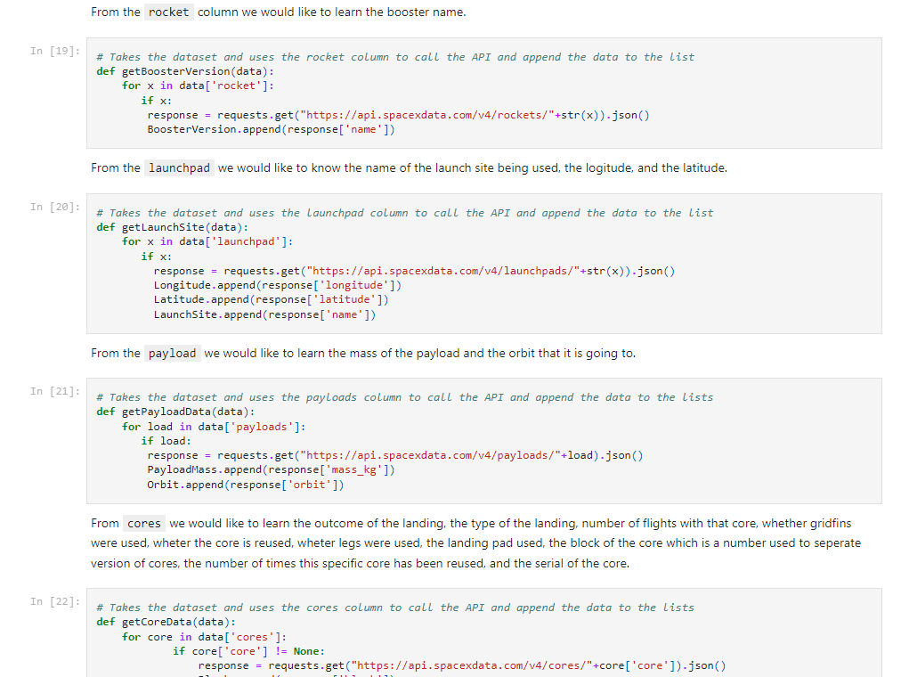
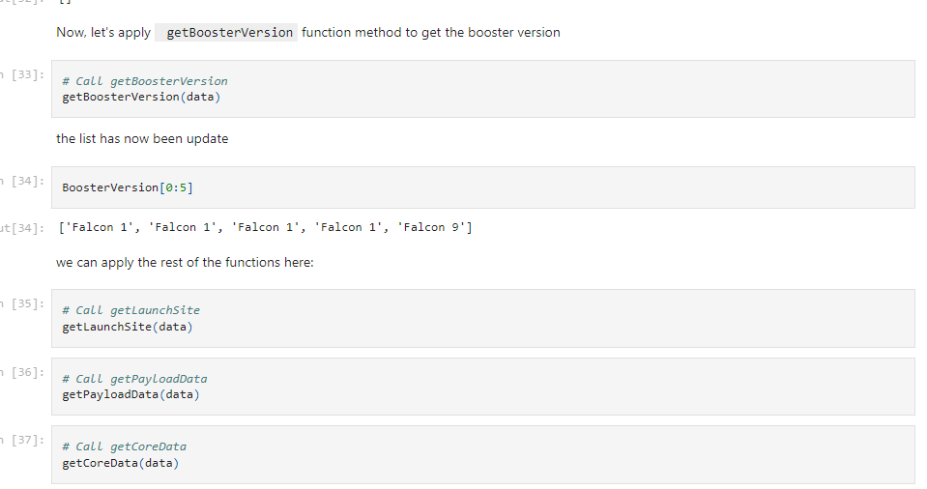
Data Collection – SpaceX API
Data collected using Rest API and using function and transformed to DataFrame for Presentation
GitHub URL :
https://github.com/maxh8086/Data-Science-Project/blob/main/jupyter-labs-spacex-data-collection-api%20(1).ipynb

Slide 9
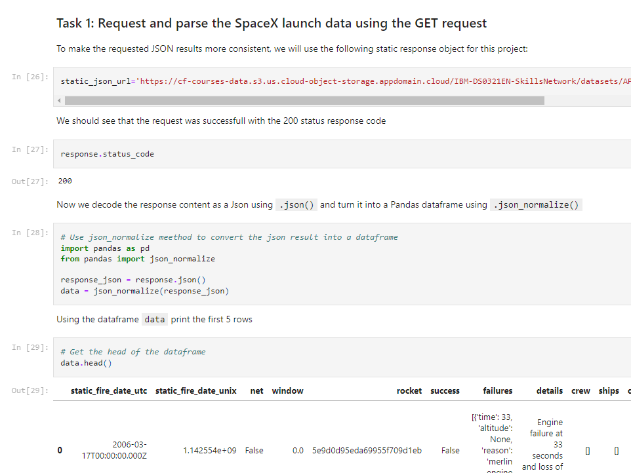
Data Collection - Scraping
We collected data using Web Scraping to Cloud object, Transform collected data in to necessary Format and Performed data wrangling and presentation.
GitHub URL of Capstone Project :
https://github.com/maxh8086/Data-Science-Project

Slide 10
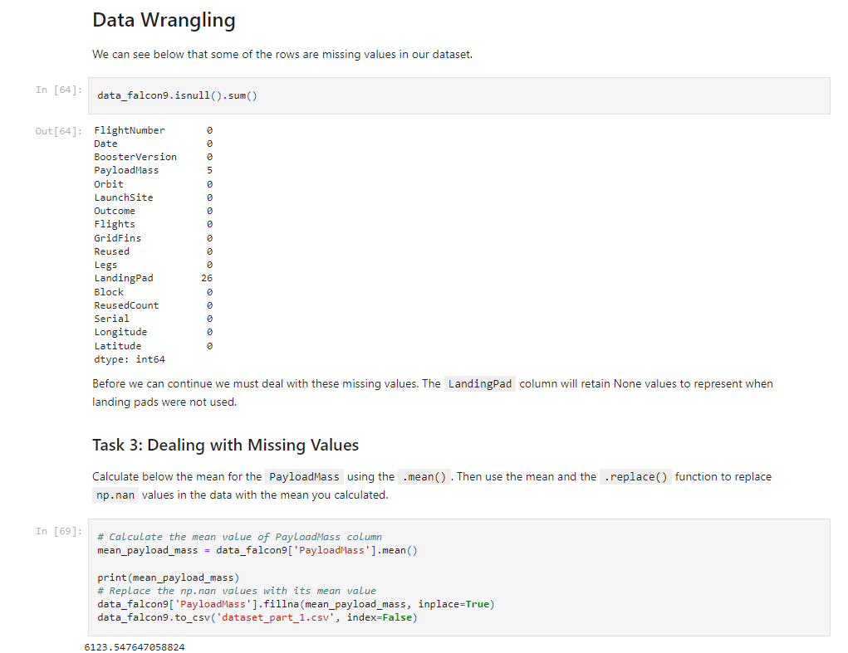
Data Wrangling
Data was collected through Web scraping, Performed Data wrangling to remove Null values and missing values.
GitHub Project URL :
https://github.com/maxh8086/Data-Science-Project/blob/main/jupyter-labs-spacex-data-collection-api%20(1).ipynb

Slide 11
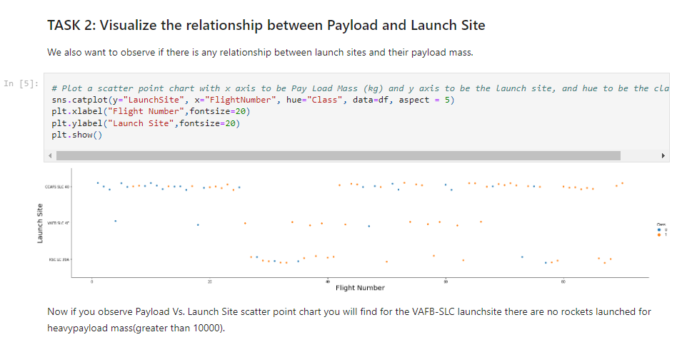
EDA with Data Visualization
Scatter point graph was plotted to visualize the relationship between Payload and Launch Site
GitHub URL :
https://github.com/maxh8086/Data-Science-Project/blob/main/EDA%20with%20Data%20Visualization.ipynb

Slide 12
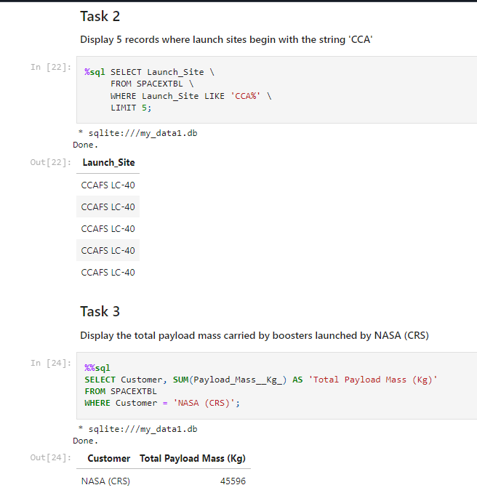
EDA with SQL
SQL Queries used to perform Exploratory analysis
Select Distinct Launch_Site from SPACEXTBL
SELECT Launch_Site FROM SPACEXTBL WHERE Launch_Site LIKE 'CCA%' LIMIT 5;
SELECT Customer, SUM(Payload_Mass__Kg_) AS 'Total Payload Mass (Kg)' FROM SPACEXTBL WHERE Customer = 'NASA (CRS)';
GitHub URL :
https://github.com/maxh8086/Data-Science-Project/blob/main/jupyter-labs-eda-sql-coursera_sqllite.ipynb

Slide 13
Build an Interactive Map with Folium
All launch sites was marked and added map objects such as markers, circles, lines to mark the success or failure of launches for each site on the folium map.
Assigned the feature launch outcomes (failure or success) to class 0 and 1.i.e., 0 for failure, and 1 for success.
identified which launch sites have relative high success rate using the color-labeled marker clusters.
Calculated the distances between a launch site to its proximities.
GitHub URL: https://github.com/maxh8086/Data-Science-Project/blob/main/lab-jupyter-launch-site-location-v2.ipynb

Slide 14
Build a Dashboard with Plotly Dash
We built an interactive dashboard with Plotly dash
We plotted pie charts showing the total launches by a certain sites
We plotted scatter graph showing the relationship with Outcome and Payload Mass (Kg) for the different booster version.
GitHub URL : https://github.com/maxh8086/Data-Science-Project/blob/main/spacex_dash_app.py

Slide 15
Predictive Analysis (Classification)
To perform and analyse predictive analysis performance data Was collected using Blob and converted to DataFrame, Data was Transformed for Analysis using Machine Learning Model sklearn, Numpy. Data was split for training and testing multiple model for comparison of performance. Hypothecation analysis was performed using Logistic Regression, Support Vector Machine, Decision Tree classifier, Kneighbors Classifier where Logistic Regression and Decision Tree classifier was able to predict outcome most accurately.
GitHub URL : https://github.com/maxh8086/Data-Science-Project/blob/main/SpaceX-Machine-Learning-Prediction-Part-5-v1.ipynb

Slide 16
Results
Exploratory data analysis results
Interactive analytics demo in screenshots
Predictive analysis results

Slide 17

Section 2

Slide 18
Flight Number vs. Launch Site
Show a scatter plot of Flight Number vs. Launch Site
Show the screenshot of the scatter plot with explanations

Slide 19
Payload vs. Launch Site
Show a scatter plot of Payload vs. Launch Site
Show the screenshot of the scatter plot with explanations

Slide 20
Success Rate vs. Orbit Type
Show a bar chart for the success rate of each orbit type
Show the screenshot of the scatter plot with explanations

Slide 21
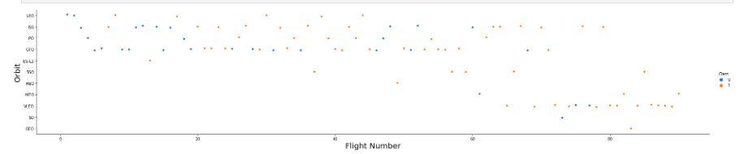
Flight Number vs. Orbit Type
scatter point of Flight number vs. Orbit type
LEO orbit the Success appears related to the number of flights; on the other hand, there seems to be no relationship between flight number when in GTO orbit.

Slide 22
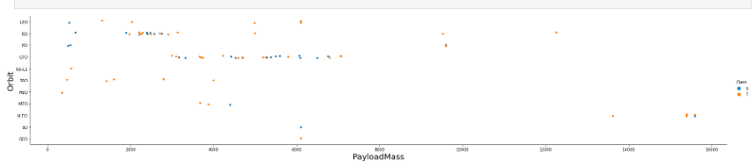
Payload vs. Orbit Type
scatter point of payload vs. orbit type
With heavy payloads the successful landing or positive landing rate are more for Polar,LEO and ISS.
However for GTO we cannot distinguish this well as both positive landing rate and negative landing(unsuccessful mission) are both there here.

Slide 23
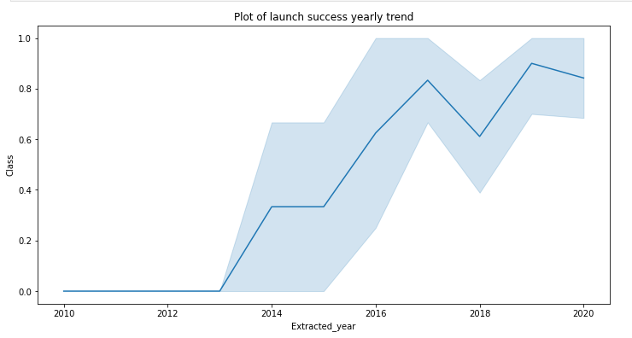
Launch Success Yearly Trend
Lchart of yearly average success rate
you can observe that the success rate since 2013 kept increasing till 2020

Slide 24
All Launch Site Names
Total 4 Sites were used in all Missions CCAFS LC-40, VAFB SLC-4E, KSC LC-39A, CCAFS SLC-40 where total 100 successful and 1 Failed mission was recorded.

Slide 25
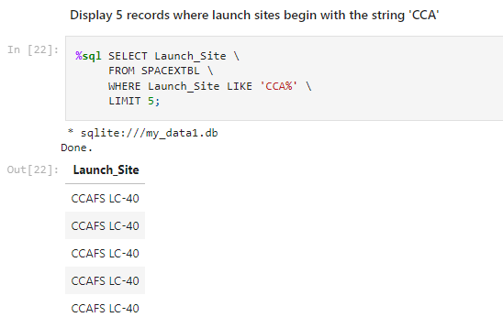
Launch Site Names Begin with 'CCA'
5 records where launch sites begin with `CCA`

Slide 26
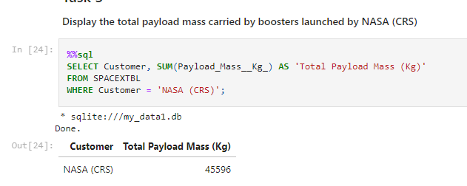
Total Payload Mass
Total 45596 payload was carried by boosters from NASA (CRS) throughout 101 missions.

Slide 27
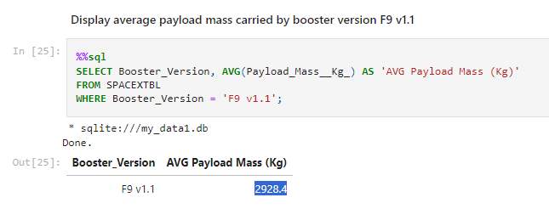
Average Payload Mass by F9 v1.1
The average payload mass carried by booster version F9 v1.1 was 2928.4

Slide 28
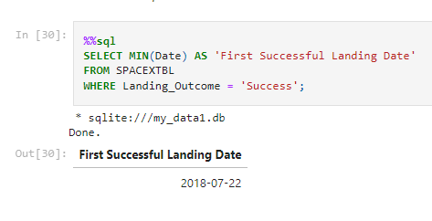
First Successful Ground Landing Date
The first successful landing outcome on ground pad was recorded on 2018-07-22.

Slide 29
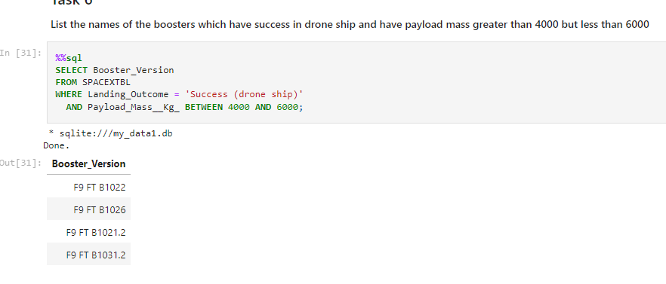
Successful Drone Ship Landing with Payload between 4000 and 6000
List of boosters which have successfully landed on drone ship and had payload mass greater than 4000 but less than 6000

Slide 30
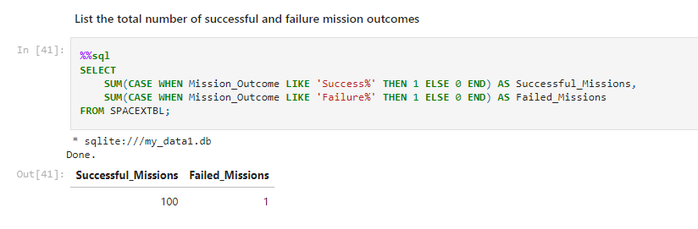
Total Number of Successful and Failure Mission Outcomes
Calculate the total 100 of successful and 1 failure mission was recorded.

Slide 31
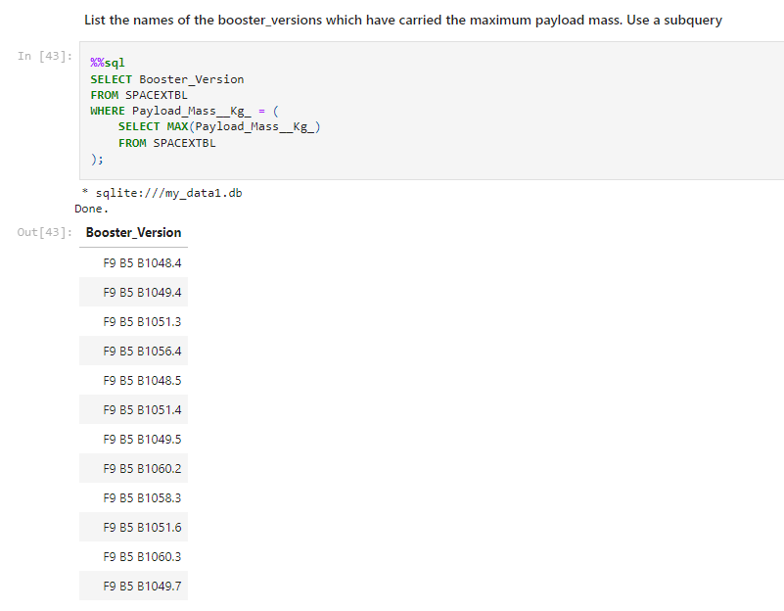
Boosters Carried Maximum Payload
List the names of the booster which have carried the maximum payload mass

Slide 32
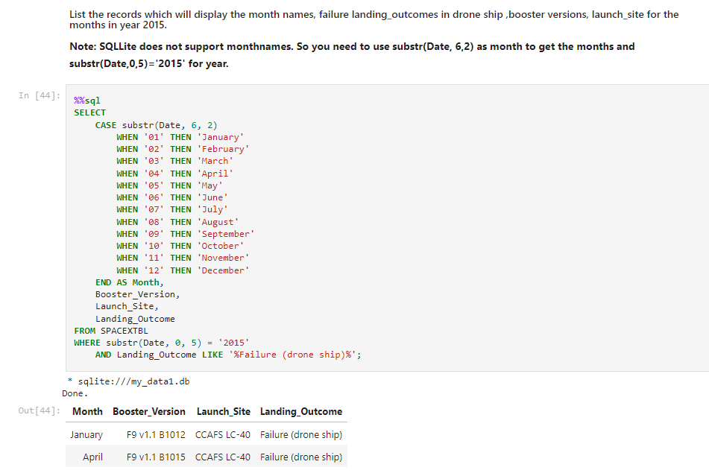
2015 Launch Records
List of the failed landing_outcomes in drone ship with their booster versions, and launch site names for in year 2015.

Slide 33
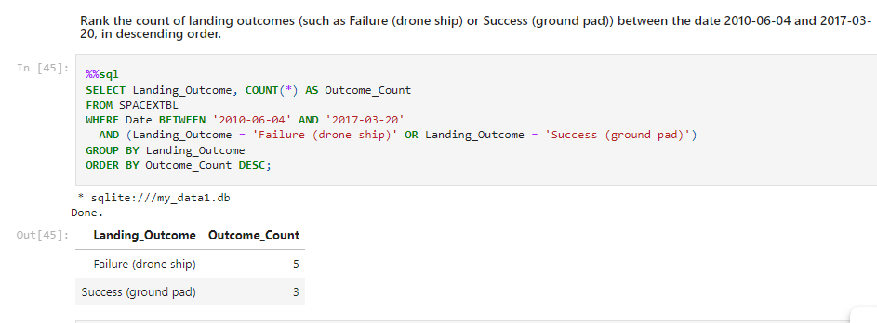
Rank Landing Outcomes Between 2010-06-04 and 2017-03-20
Rank the count of landing outcomes (such as Failure (drone ship) or Success (ground pad)) between the date 2010-06-04 and 2017-03-20, in descending order

Slide 34

Section 3

Slide 35
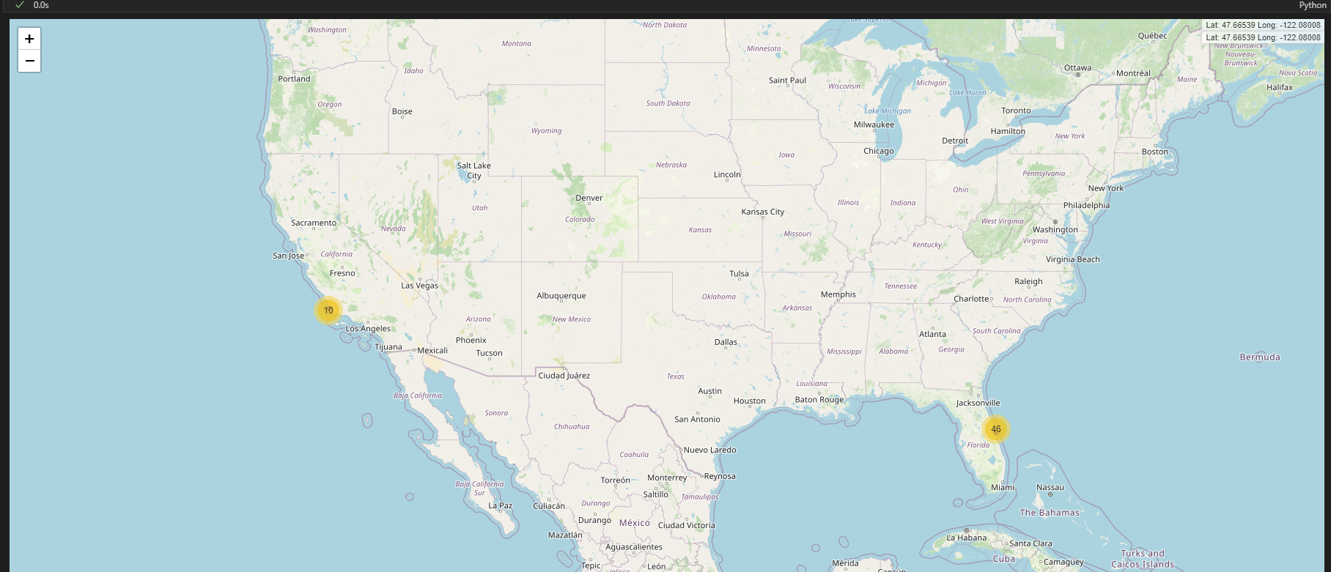
All launch sites global map markers
Total 46 Launch operations was performed from Cape Canaveral Space Station and 10 Launch operations was performed from Vandenberg Space Station

Slide 36
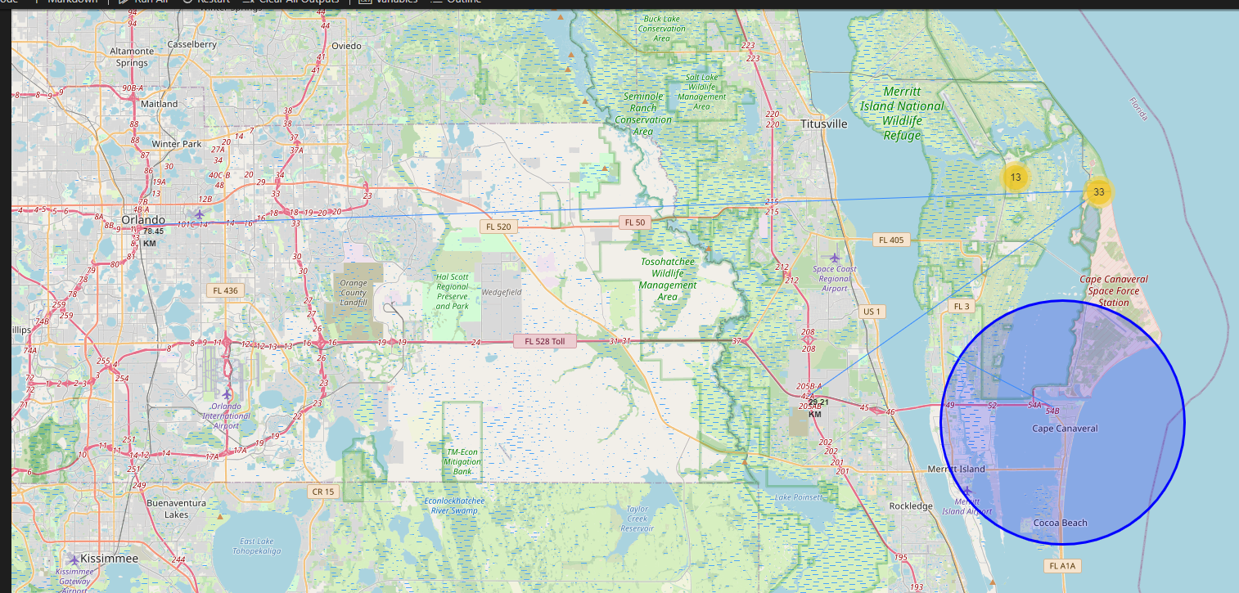
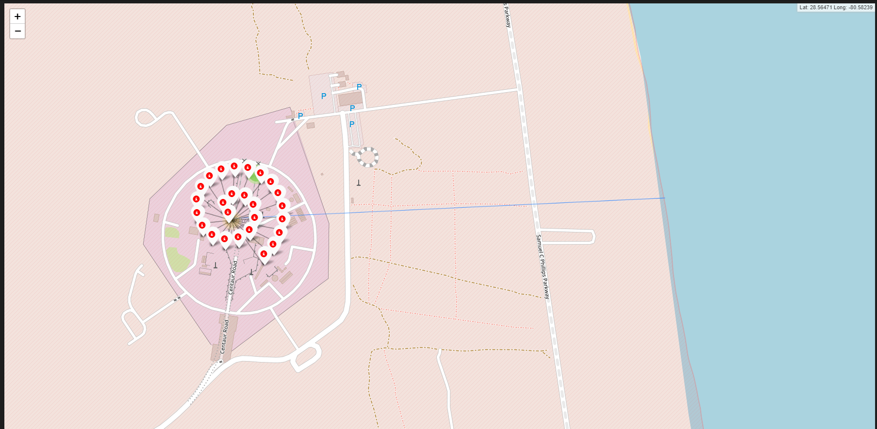
Cape Canaveral space station
Falcon 9 Launchpad

Slide 37

Launch Site distance to landmarks

Slide 38

Section 4

Slide 39
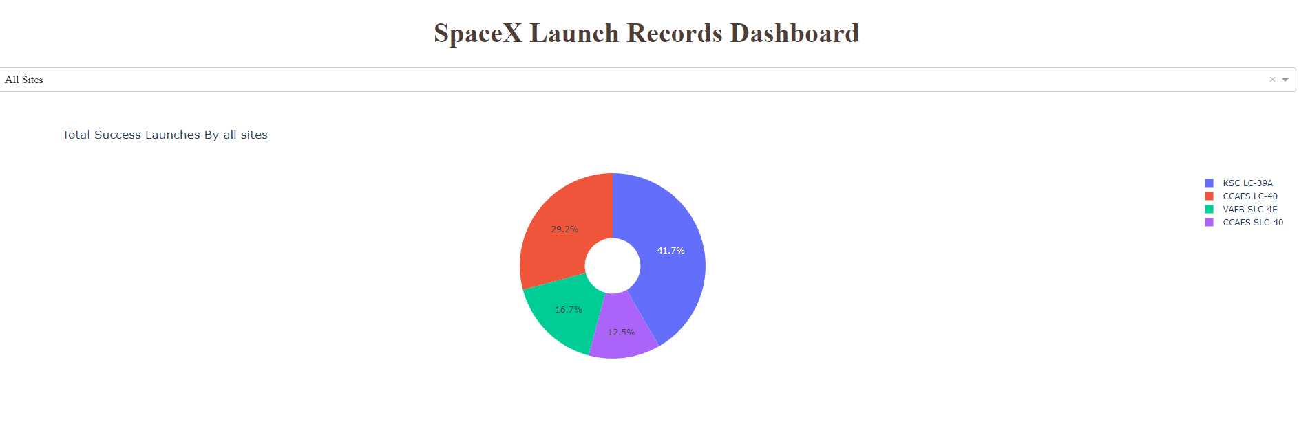
Dashboard Application with Plotly Dash
Out of 4 Sites, KSC LC 39A has most successful Launch

Slide 40
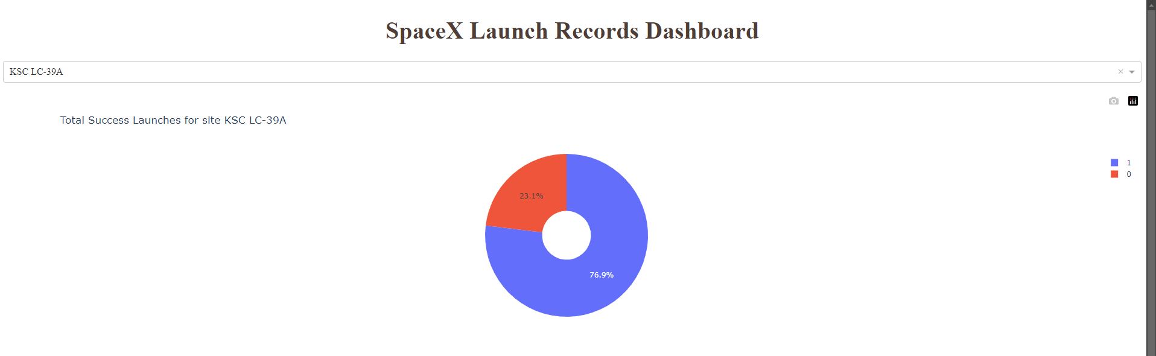
Launch site with the highest Success ratio
KSC LS 39A has 76.9% Launch success ratio

Slide 41
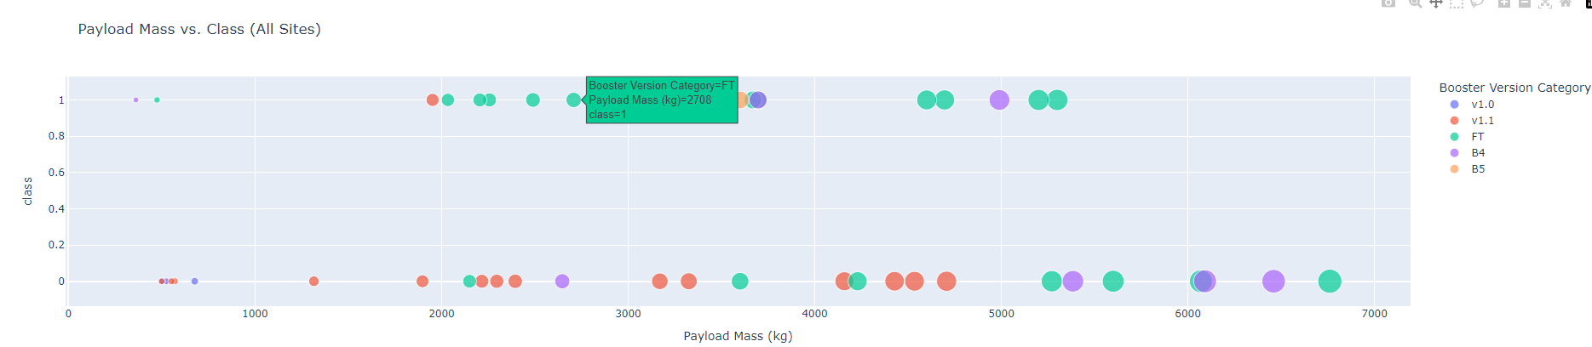
Payload vs. Launch Outcome
FT Booster version have the largest success rate across range.

Slide 42

Section 5

Slide 43
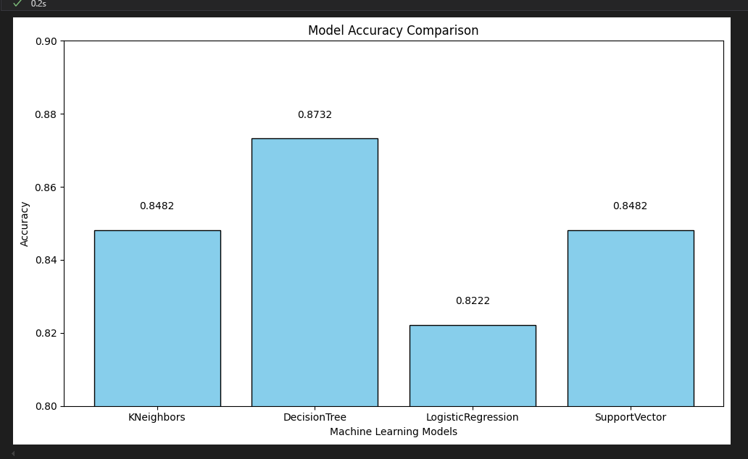
Classification Accuracy
DecisionTree model has the highest classification accuracy with a score of 0.8732

Slide 44
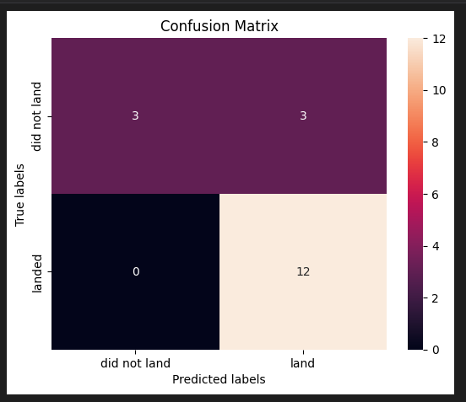
Confusion Matrix
The confusion matrix for the decision tree classifier shows that the classifier can distinguish between the different classes. The major problem is the false positives .i.e., unsuccessful landing marked as successful landing by the classifier

Slide 45
Conclusions
We can conclude that:
The larger the flight amount at a launch site, the greater the success rate at a launch site.
Launch success rate started to increase in 2013 till 2020.
Orbits ES-L1, GEO, HEO, SSO, VLEO had the most success rate.
KSC LC-39A had the most successful launches of any sites.
The Decision tree classifier is the best machine learning algorithm for this task.

Slide 46


